Slide 1


Carry Look Ahead Adder
ECE-111 Advanced Digital Design Project

Slide 2
Let’s understand First Ripple Carry Adder !
A Ripple Carry Adder is made of a number of full adders cascaded together.
Since carry bit from previous full adder ripples (connected) to the next full adder, hence the name Ripple carry adder
It is used to add together two binary numbers using simple logic gates
Ripple-carry adder is relatively slow, since each full adder must wait for the carry bit to be calculated from the previous full adder.
The figure below shows 4 full-adders connected together to produce a 4-bit ripple carry adder.
only the first full adder may be replaced by a half adder (under the assumption that C[0]= 0).
A[3]
B[3]
A[2]
B[2]
A[1]
B[1]
A[0]
B[0]
1-bit Full Adder
Inst3
C[3]
1-bit Full Adder
Inst2
C[2]
1-bit Full Adder
Inst1
C[1]
1-bit Full Adder
Inst0
C[4]
C[0] (same as Cin)
S[3]
S[2]
S[1]
S[0]
4-bit Ripple Carry Adder

Slide 3
How to develop Ripple Carry Adder using Generate
module ripple_carry_adder #(parameter N = 4)(
input [N-1:0] A, B,
input CIN,
output logic[N:0] result);
logic[N:0] l_carry;
logic[N-1:0] l_sum;
// assign Carry in to first full adder carryin
assign l_carry[0] = CIN;
// Instantiate Full Adder for 'N' instances
genvar i;
generate
for(i=0; i<N; i=i+1) begin: fa_loop
fulladder fa_inst(
.a(A[i]),
.b(B[i]),
.cin(l_carry[i]),
.sum(l_sum[i]),
.cout(l_carry[i+1]));
end: fa_loop
endgenerate
// final result of addition and carry
assign result = {l_carry[N], l_sum};
endmodule: ripple_carry_adder
fulladder fa_inst0(
.a(A[0]),
.b(B[0]),
.cin(l_carry[0]),
.sum(l_sum[0]),
.cout(l_carry[1]);
fulladder fa_inst1(
.a(A[1]),
.b(B[1]),
.cin(l_carry[1]),
.sum(l_sum[1]),
.cout(l_carry[2]);
fulladder fa_inst2(
.a(A[2]),
.b(B[2]),
.cin(l_carry[2]),
.sum(l_sum[2]),
.cout(l_carry[3]);
fulladder fa_inst3(
.a(A[3]),
.b(B[3]),
.cin(l_carry[3]),
.sum(l_sum[3]),
.cout(l_carry[4]);
genvar ‘i’ controls generate for loop iteration
generate for loop statement will create ‘N’ number of full adder module instances
mandatory to have named for loop inside generate body

Slide 4
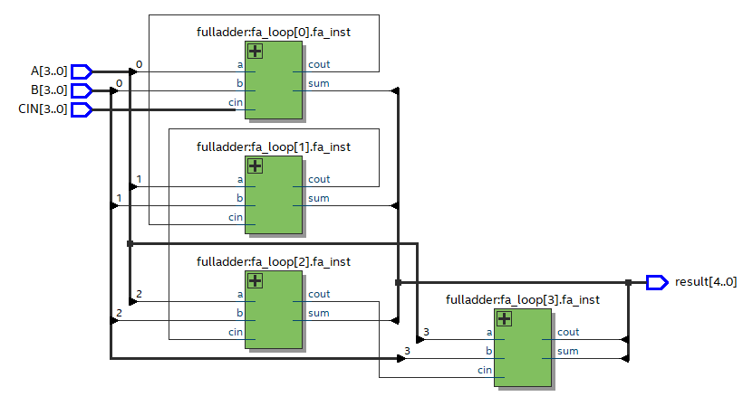
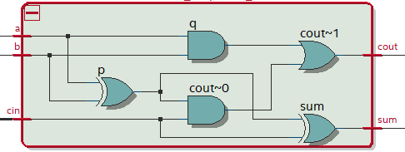
Ripple Carry Adder Post Synthesis Netlist
Full Adder Logic
Why this particular implementation of carry chain? Can we do any better?

Slide 5
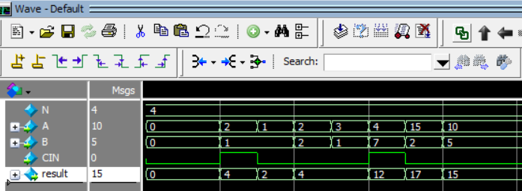
Ripple Carry Adder Simulation Snapshot

Slide 6
Carry Lookahead Adder
A Carry Lookahead Adder is made of a number of full adders cascaded together.
Carry lookahead adder is similar like ripple carry adder with the difference that it calculates the carry bit for each full adder instance before the full adder operation on inputs is performed.
Generate and Propagate Carry Logic depend only on inputs A, B, very first Carry input (C[0]). These values are all known upfront.
Since Carry input for each Full Adder instance is generated upfront, all full adder instances can concurrently perform add operation on its respective input bits and input carry
Advantage of carry lookahead adder is that it adds two numbers faster than ripple carry adder
The drawback is that carry lookahead adder takes more logic gates to implement. So higher resource usage (frequent tradeoff)
If faster performance is required when adding two number then select carry lookahead adder as implementation choice
For lower resource usage requirement, ripple carry adder can be selected as an implementation choice
The figure below shows 4 full-adders connected together to produce a 4-bit lookahead carry adder.
A[3]
B[3]
A[2]
B[2]
A[1]
B[1]
A[0]
B[0]
1-bit Full Adder
Inst3
C[3]
1-bit Full Adder
Inst2
C[2]
1-bit Full Adder
Inst1
C[1]
1-bit Full Adder
Inst0
C[0] (Cin)
4-bit Carry Lookahead
Adder
Only depends
On Inputs A[3:0], B[3:0] and C[0]
to generate Carry C[1],C[2],C[3],C[4]
S[3]
S[2]
S[1]
S[0]
C[4]
Carry Lookahead Logic (generate and propagate carry)
A[3]
B[3]
A[2]
B[2]
A[1]
B[1]
A[0]
B[0]

Slide 7
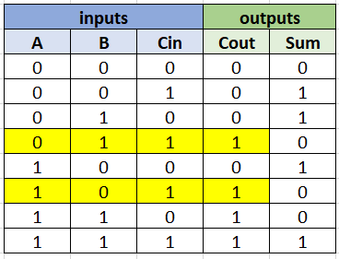
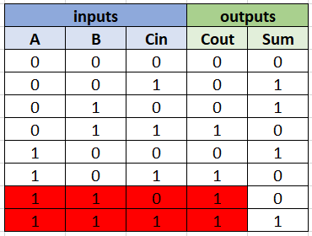
Carry Lookahead Adder Hint (Carry Out Boolean Expression)
In Yellow marked rows in full adder truth table, Cout = 1 when either A=1 or B =1, provided Cin = 1
In another words, incoming carry (Cin=1) is propagated to carry out (Cout) if one of the input’s is 1 and other is 0
This can be represented as : (A[i] | B[i]) & Cin[i]
This is known as propagate carryin to carryout
In red marked rows in full adder truth table, Cout = 1 when both A = 1 and B = 1, whether Cin = 1 or 0
A carry out (Cout) is generated if both A and B are 1 irrespective of the fact that previous carry (Cin) was 1 or 0
This can be represented as : A[i] & B[i]
This is known as generate carryout
Hence final Boolean expression for Carry out (Cout) generation is combination of above mentioned :
Cout[i+1] = ((A[i] | B[i]) & Cin[i]) | (A[i] & B[i])
Full Adder Truth Table

Slide 8
Carry Kill, Anyone?
We saw how to do carry generate and carry propagate.
Generate produces carry_out = 1 w/o waiting for carry_in.
Propagate passes carry_in to carry out, but faster than ripple.
Could we somehow make a carry kill, which produces carry_out = 0?
Any advantage?

Slide 9
Carry Lookahead Adder Hint (Carry Out Boolean Expression)
Carry Generate : G(i) = (A[i].B[i]) // Note : & is represented as .
Carry Propagate : P(i) = (A[i]+B[i]) // Note : | is represented as +
Generate and Propagate Carry : C[i+1] = G[i] + P[i].C[i]
Carry inputs for each Full Adder Instance equations can be expanded as shown below
C[1] = G[0] + P[0].C[0]
= G[0] + P[0].Cin // Note : Replaced C[0] with Cin. C[0] is the input carry to first stage full adder
C[2] = G[1] + P[1].C[1] // Note : C[1] can be replaced with G[0] + P[0].Cin
= G[1] + P[1] (G[0] + P[0].Cin)
= G[1] + P[1].G[0] + P[1].P[0].Cin
C[3] = G[2] + P[2].C[2] // Note : C[2] can be replaced with G[1] + P[1].G[0] + P[1].P[0].Cin
= G[2] + P[2] (G[1] + P[1].G[0] + P[1].P[0].Cin)
= G[2] + P[2].G[1] + P[2].P[1].G[0] + P[2].P[1].P[0].Cin
C[4] = G[3] + P[3].C[3] // Note : C[3] can be replaced with G[2] + P[2].G[1] + P[2].P[1].G[0] + P[2].P[1].P[0].Cin
= G[3] + P[3] (G[2] + P[2].G[1] + P[2].P[1].G[0] + P[2].P[1].P[0].Cin)
= G[3] + P[3].G[2] + P[3].P[2].G[1] + P[3].P[2].P[1].G[0] + P[3].P[2].P[1].P[0].Cin

Slide 10
Carry Lookahead Adder Hint (Carry Out Boolean Expression)
G[i] and P[i] can be further replaced with A[i].B[i] and A[i]+B[i] below in each of the C[1], C[2], C[3], C[4] carry equations
C[1] = G[0] + P[0].Cin
= (A[0].B[0]) + (A[0]+B[0]).Cin
C[2] = G[1] + P[1].G[0] + P[1].P[0].Cin
= (A[1].B[1]) + (A[1]+B[1]). (A[0].B[0]) + (A[1]+B[1]). (A[0]+B[0]).Cin
C[3] = G[2] + P[2].G[1] + P[2].P[1].G[0] + P[2].P[1].P[0].Cin
= (A[2].B[2]) + ((A[2]+B[2]).(A[1].B[1])) + ((A[2]+B[2]). (A[1]+B[1]).(A[0].B[0])) + ((A[2]+B[2]).(A[1]+B[1]).(A[0]+B[0]).Cin)
C[4] = G[3] + P[3].G[2] + P[3].P[2].G[1] + P[3].P[2].P[1].G[0] + P[3].P[2].P[1].P[0].Cin
= (A[3].B[3]) + ((A[3]+B[3]).(A[2].B[2])) + ((A[3]+B[3]). (A[2]+B[2]).(A[1].B[1])) + ((A[3]+B[3]). (A[2]+B[2]).(A[1]+B[1]).(A[0].B[0])) + ((A[3]+B[3]). (A[2]+B[2]).(A[1]+B[1]).(A[0]+B[0]).Cin)
C[1],C[2],C[3],C[4] depends on inputs A[0], A[1], A[2], A[3], B[0], B[1], B[2], B[3] and Cin, whose values are known upfront and hence Carry inputs C[1] to C[4] can be computed right away and hence all 4 full adders can perform operation simultaneously to allow fast add operation !

Slide 11
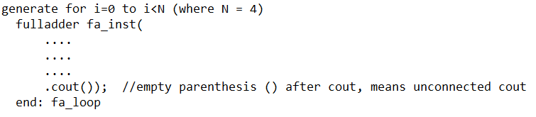
Carry Lookahead Adder Implementation Hint
Example: instantiate 4 Full Adder Modules using “generate for” statement
As per diagram below Cout from each full adder is not passed to next Full Adder hence in each of the full adder instance Cout can be left connected.
A[3]
B[3]
A[2]
B[2]
A[1]
B[1]
A[0]
B[0]
1-bit Full Adder
Inst3
C[3]
1-bit Full Adder
Inst2
C[2]
1-bit Full Adder
Inst1
C[1]
1-bit Full Adder
Inst0
C[0] (Cin)
4-bit Carry Lookahead
Adder
S[3]
S[2]
S[1]
S[0]
C[4]
Carry Lookahead Logic (generate and propagate carry)
A[3]
B[3]
A[2]
B[2]
A[1]
B[1]
A[0]
B[0]

Slide 12
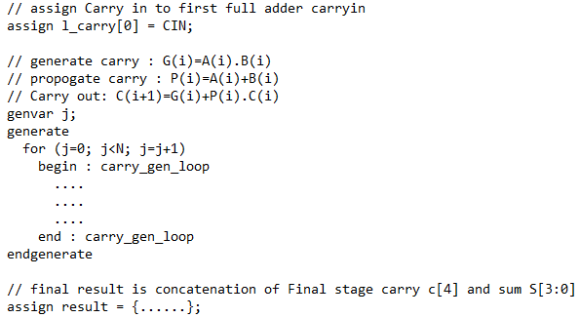
Carry Lookahead Adder Implementation Hint
C[1], C[2], C[3], C[4] carryout are based on previous A and B inputs.
C[1], C[2], C[3], C[4] each is created from “generate and propagate carry” logic.
This can be implemented by using below mentioned Boolean expression and putting this logic in generate for statement
declare logic[N:0] l_carry; // N = 4
Using generate for where i is 0 to 3 create l_carry[1] to l_carry[4] which is same as C[1] to C[4] in diagram on previous page
assign l_carry[i+1] = ( (A[i] | B[i]) & Cin[i] ) | ( A[i] & B[i] )
First stage full adder Carryin C[0] is, l_carry[0] = CIN (CIN is input signal)
Final out result = {l_carry[N], S[3], S[2], S[1], S[0]} // where S[0], S[1], S[2], S[3] is “sum” output from each full adder instance
Remember that in case of Carry Lookahead Adder, each Full Adder instance does addition of its Inputs concurrently.
Hence Carryin for each full adder has to be made available without waiting for previous full adder addition operation completion.
For each Full Adder Carry input is computed using previous full adder inputs and previous full adder carryin which is always available !
// Note : . can be represented as &
// Note : + can be represented as |
Note : continuous assign statements are allowed within generate-for begin end body

Slide 13
Homework Assignment
Develop SystemVerilog RTL model for N-bit Carry Look Ahead Adder
Run simulation using testbench provided with N=32
Synthesize carry look ahead adder design for N=4 and N=32
Review synthesis results (resource usage and RTL netlist/schematic)
Review input and output signals in simulation waveform.
Assume below mentioned primary port names and SystemVerilog RTL module name carry_lookahead_adder.
Primary Ports for carry_lookahead_adder module
Input [N-1:0] A, B
Input CIN (carryin to first stage Full Adder Instance)
Output result (final output addition result and final stage carryout)
Report should include :
SystemVerilog design and testbench code
Synthesis resource usage and schematic generated from RTL netlist viewer
Simulation snapshot and explain simulation result to confirm RTL model developed works as carry lookahead adder
A
carry_lookahead_adder
B
result[N:0]
CIN

Slide 14
Carry Look Ahead Adder Simulation Snapshot

